Slide 1
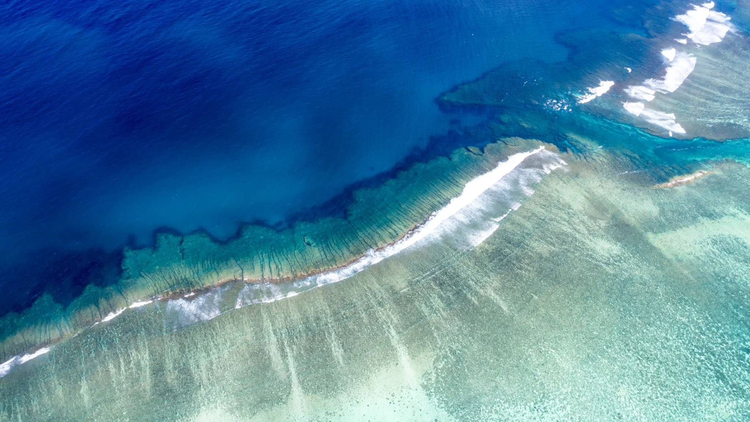

Nassau, bahamas
Aaron Padam & Nino Orton-Clarke

Slide 2
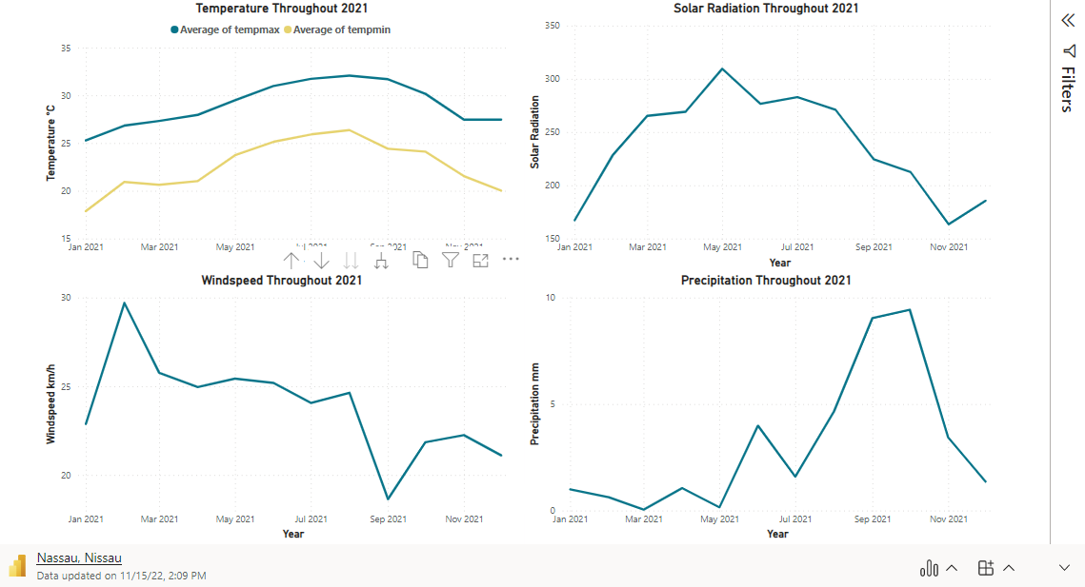
DATA

Slide 3

Flights
Houston - Nassau:
15-22 Dec this year $517 return flights
Self-transfer at MIA on both legs

Slide 4

hotel
Grand Hyatt Baha Mar
7 days and 7 nights
Airport transfer included
$550 total
All inclusive

Slide 5

Golf
Courses:
Royal Blue Golf Club
Abaco Golf Club
Albany Golf Club
Ocean Golf Club
All 18-hole courses
40 minute drive

Slide 6
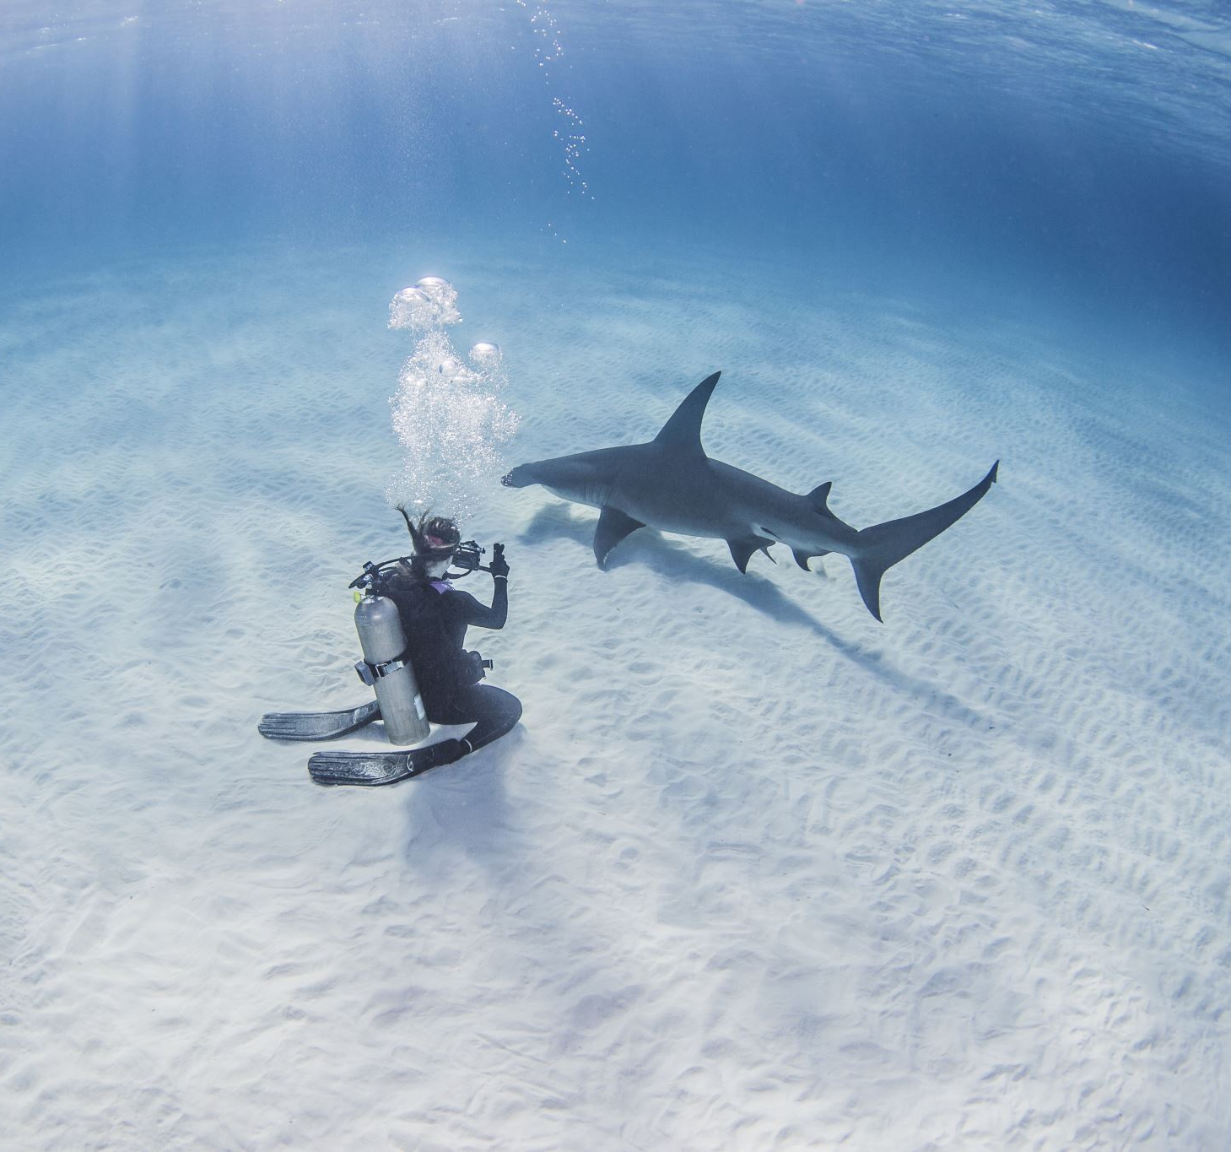
Scuba diving
Four Day Dive Package:
$539 per person
3-hour long diving sessions
Shallow reef, movie site or wreck dive
Beautiful reefs each with different coral formations and fish life

Slide 7

Thanks for listening

